Slide 1
Day 3
Session 2

Slide 2
Objectives
Exceptions Handling -
try, catch, finally, throw, throws
Custom Exceptions,
Pre Defined Exceptions,
User Defined Exception
String-
Immutable Strings
Comparing Strings
Concatenation Strings
Splitting strings
String Buffer
String Tokenizer

Slide 3
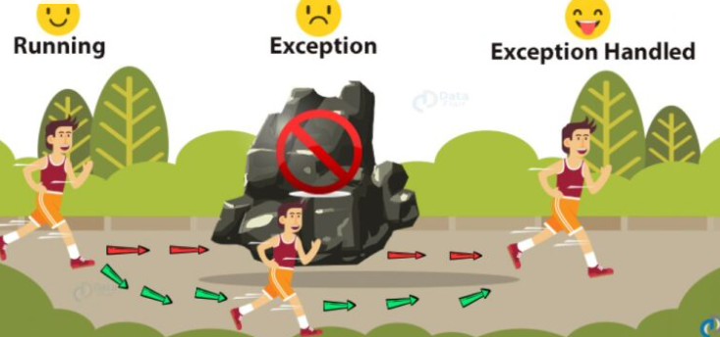
Exception Handling

Slide 4
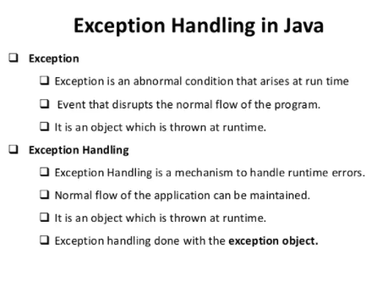
Exception Handling

Slide 5
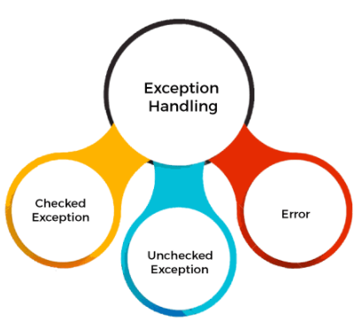
Exception Handling
Types of Java Exceptions
There are mainly two types of exceptions: checked and unchecked. An error is considered as the unchecked exception. However, according to Oracle, there are three types of exceptions namely:
Checked Exception
Unchecked Exception
Error

Slide 6
Exception Handling
Types of Java Exceptions
There are mainly two types of exceptions: checked and unchecked. An error is considered as the unchecked exception. However, according to Oracle, there are three types of exceptions namely:
Checked Exception
Unchecked Exception
Error

Slide 7
Exception Handling
Difference between Checked and Unchecked Exceptions
Checked Exception
The classes that directly inherit the Throwable class except RuntimeException and Error are known as checked exceptions. For example, IOException, SQLException, etc. Checked exceptions are checked at compile-time.
Unchecked Exception
The classes that inherit the RuntimeException are known as unchecked exceptions. For example, ArithmeticException, NullPointerException, ArrayIndexOutOfBoundsException, etc. Unchecked exceptions are not checked at compile-time, but they are checked at runtime.
Error
Error is irrecoverable. Some example of errors are OutOfMemoryError, VirtualMachineError, AssertionError etc.

Slide 8
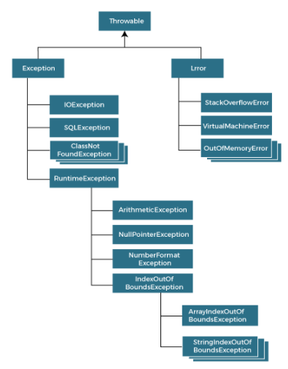
Exception Handling

Slide 9
Exception Handling
 | Keywords for Exceptional Handling
try | The "try" keyword is used to specify a block where we should place an exception code.
catch | The "catch" block is used to handle the exception.
finally | The "finally" block is used to execute the necessary code of the program. It is executed whether an exception is handled or not.
throw | The "throw" keyword is used to throw an exception.
throws | The "throws" keyword is used to declare exceptions. It specifies that there may occur an exception in the method.

Slide 10
Exception Handling
Try block is always follows by catch or finally
try catch syntax
try{
//code that may throw an exception
}catch(Exception_class_Name ref){}
Syntax of try-finally block
try{
//code that may throw an exception
}finally{}

Slide 11
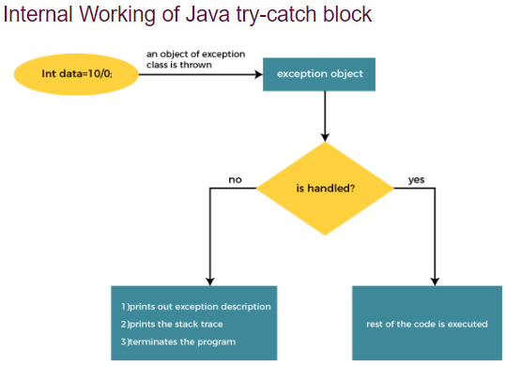
Exception Handling

Slide 12
Exception Handling
Demo try catch
Java Multi-catch block → If we won’t sure about specific exception or it may possible that there maybe we need to handle exception with multiple condition we can use multiple catch block
try-final -Java finally block is a block used to execute important code such as closing the connection, etc
D1
D2
D3

Slide 13
Exception Handling
Throws →
The Java throws keyword is used to declare an exception. It gives an information to the programmer that there may occur an exception.
Syntax of Java throws
return_type method_name() throws exception_class_name{ //method code
}
D4

